Slide 1
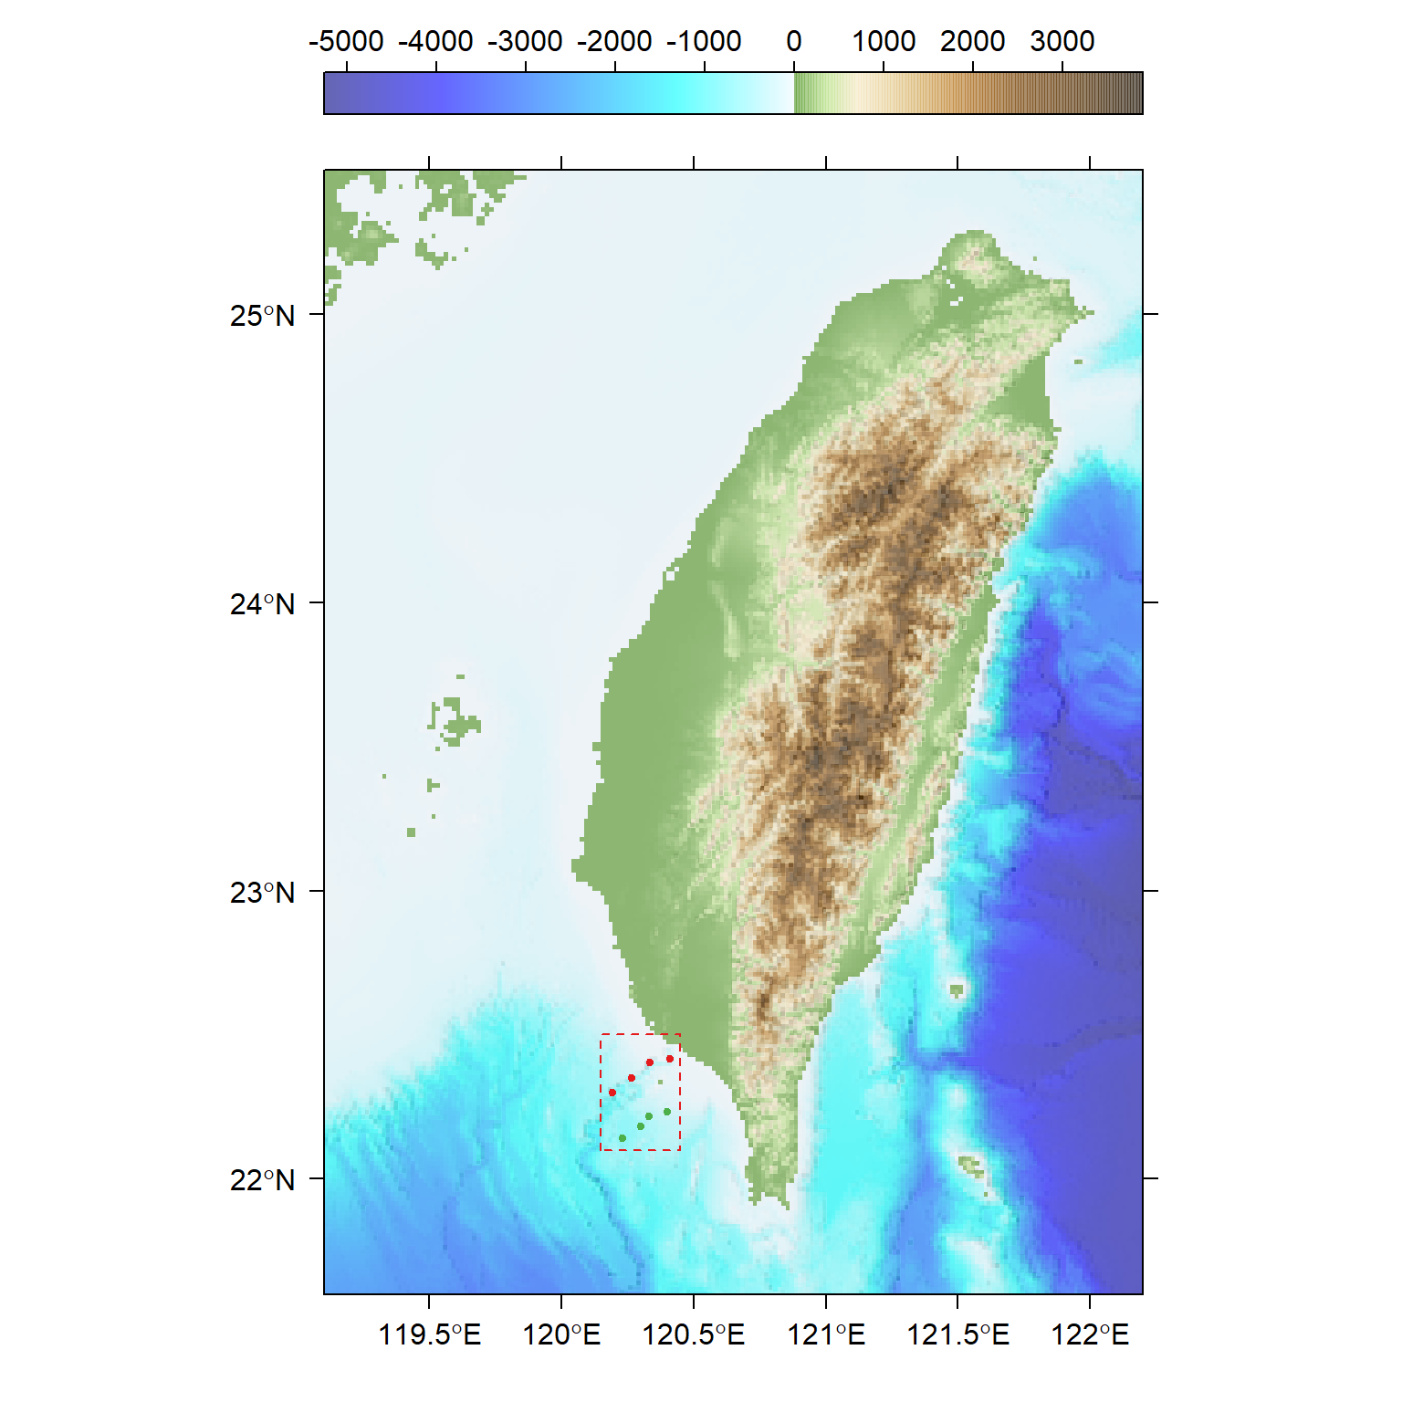
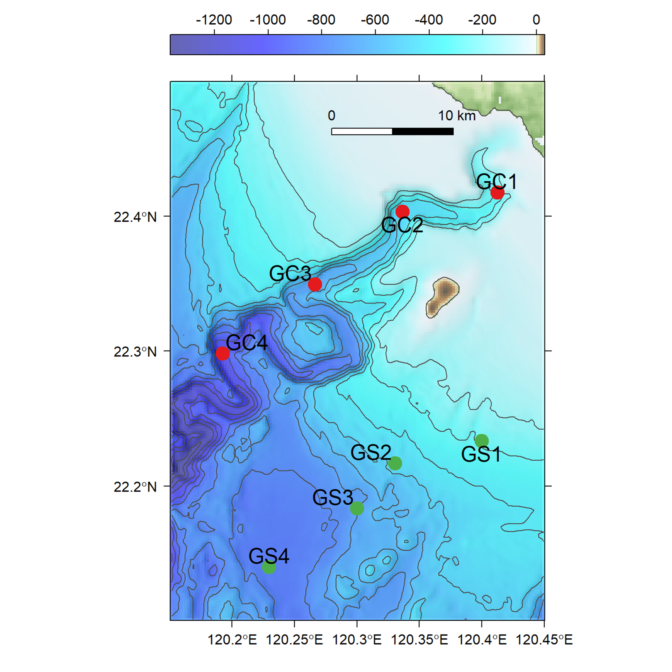
(A)
(B)
Notes:
Fig. 1 Sampling map of meiobenthos and macrobenthos

Slide 2
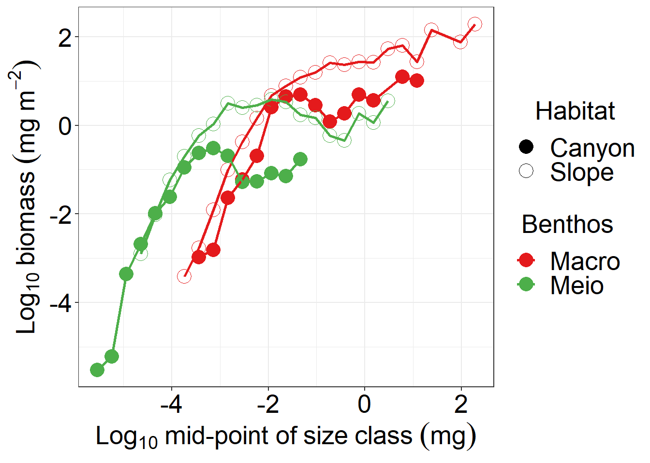
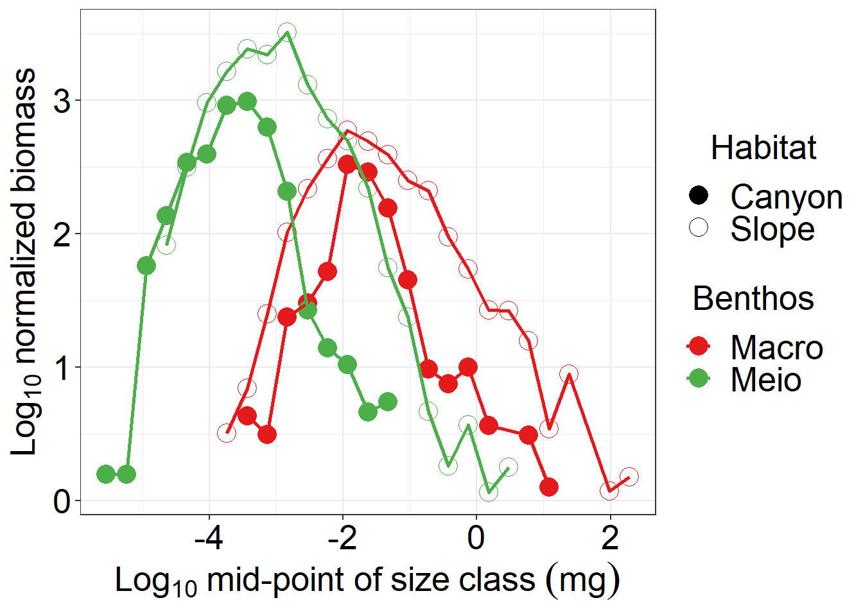
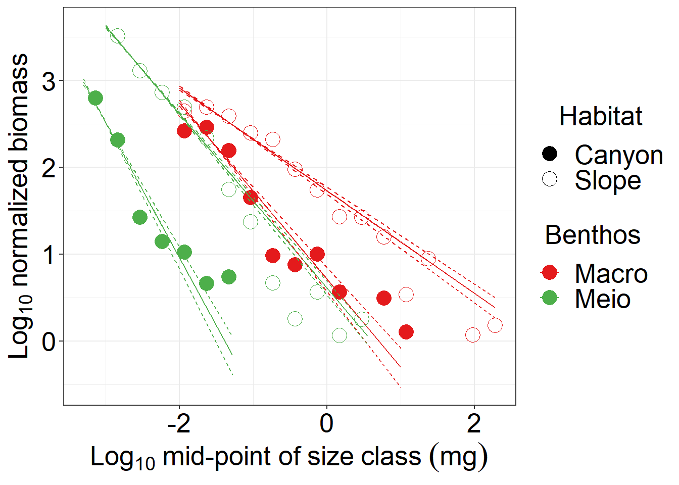
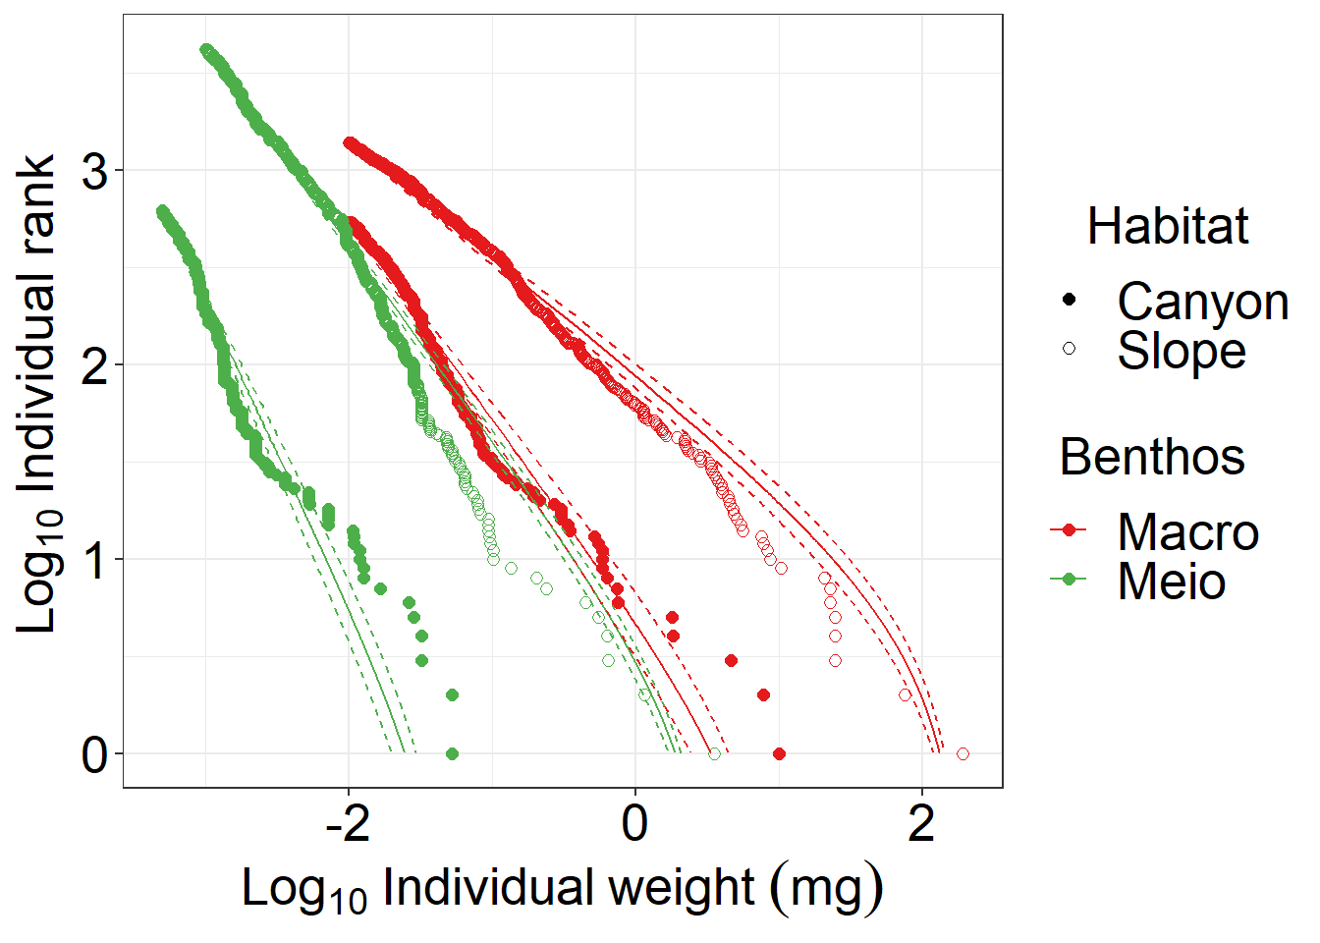
(A)
(B)
(C)
(D)
Notes:
Fig. 2 Size spectrum of meiobenthos and macrobenthos

Slide 3
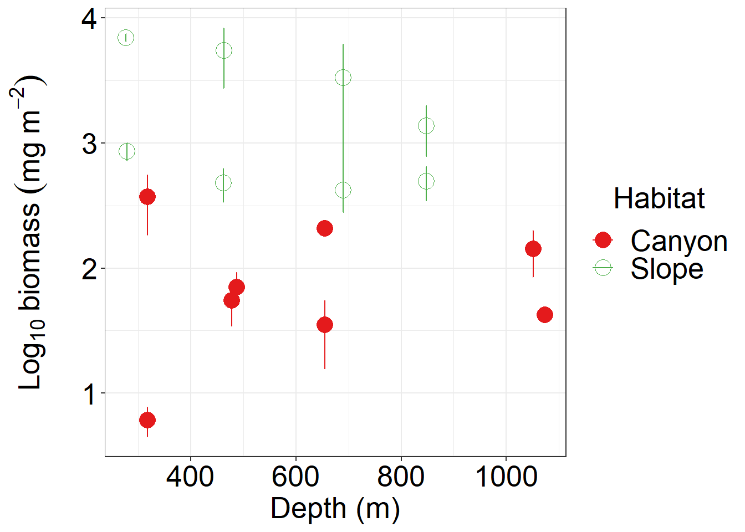
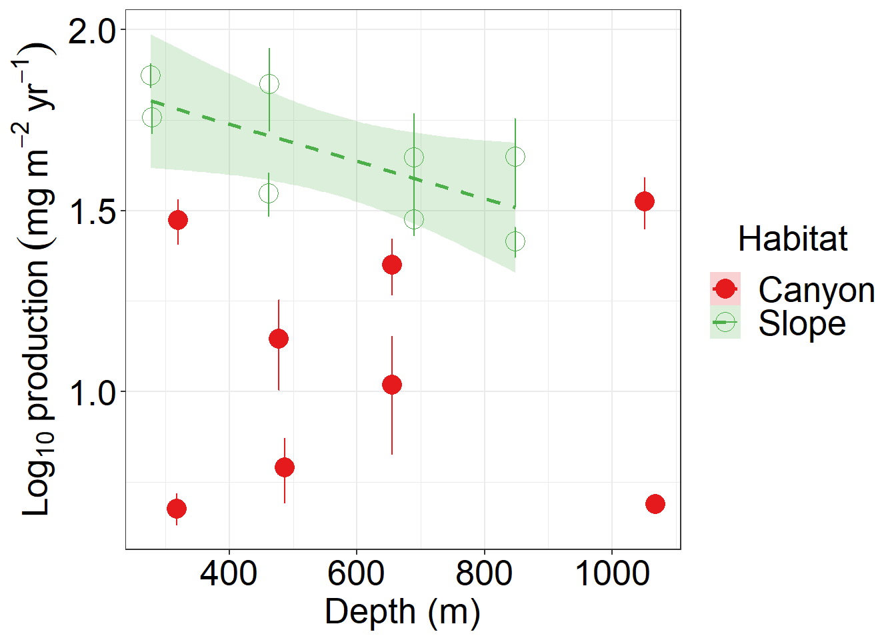
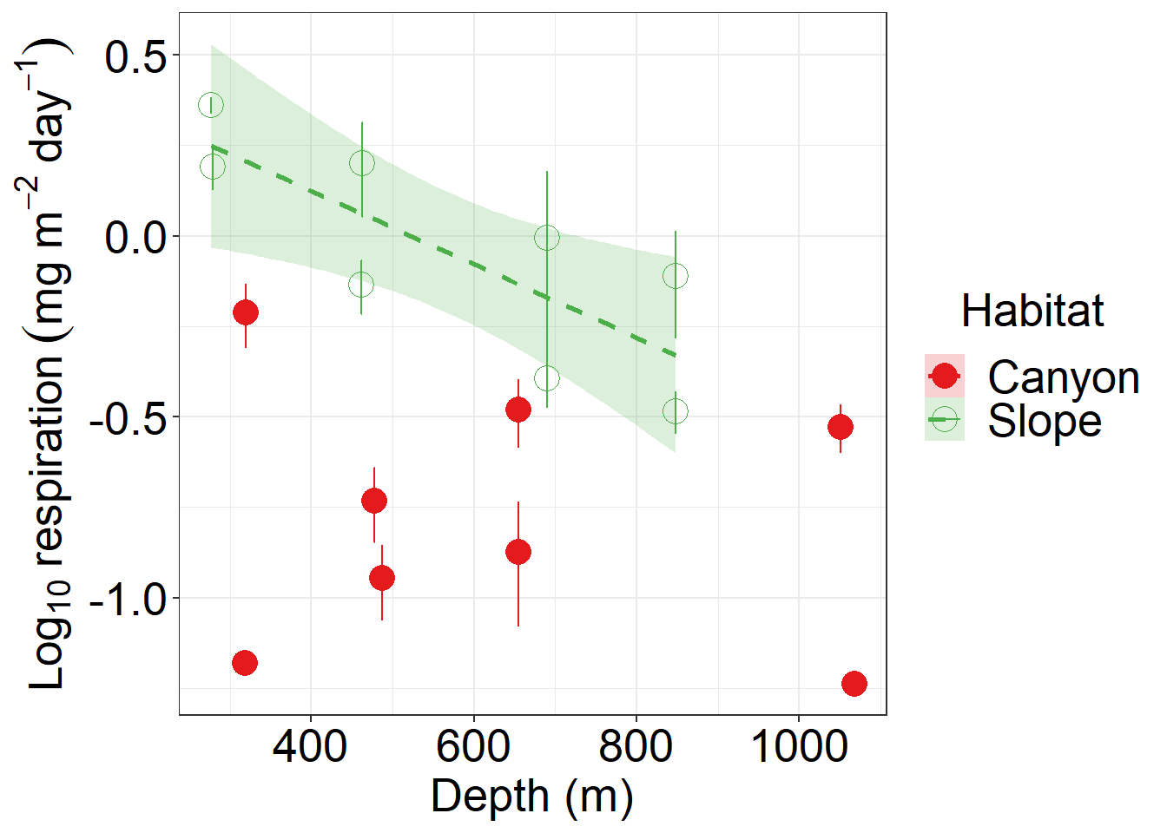
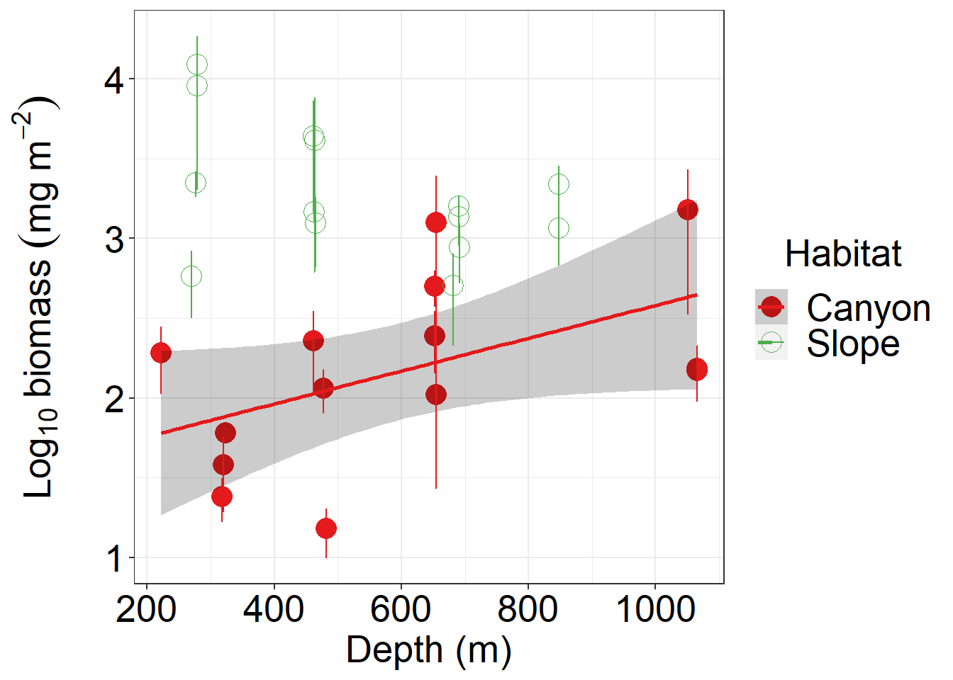
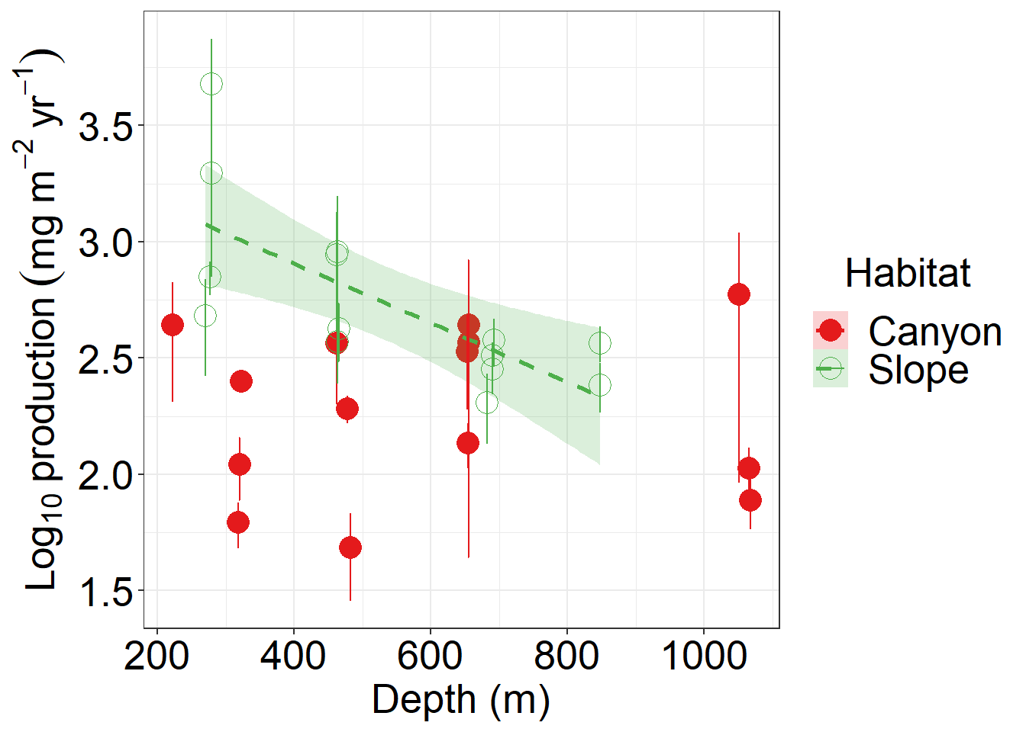
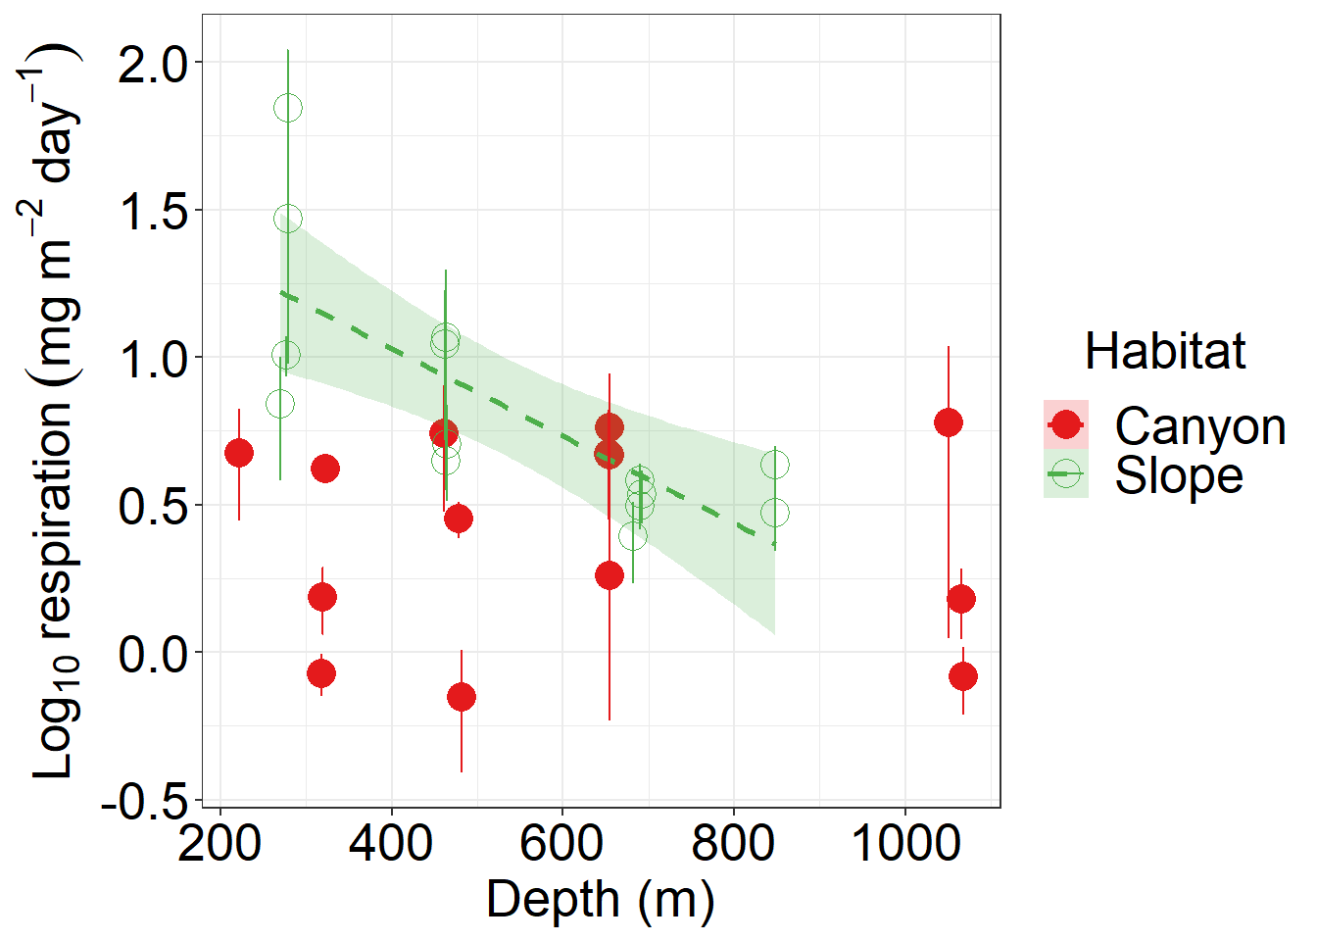
(A)
(B)
(C)
(D)
(E)
(F)
(D)
Notes:
Fig. 3. Biomass, secondary production, and respiration of meiobenthos (A-C) and macrobenthos (D-E)

Slide 4
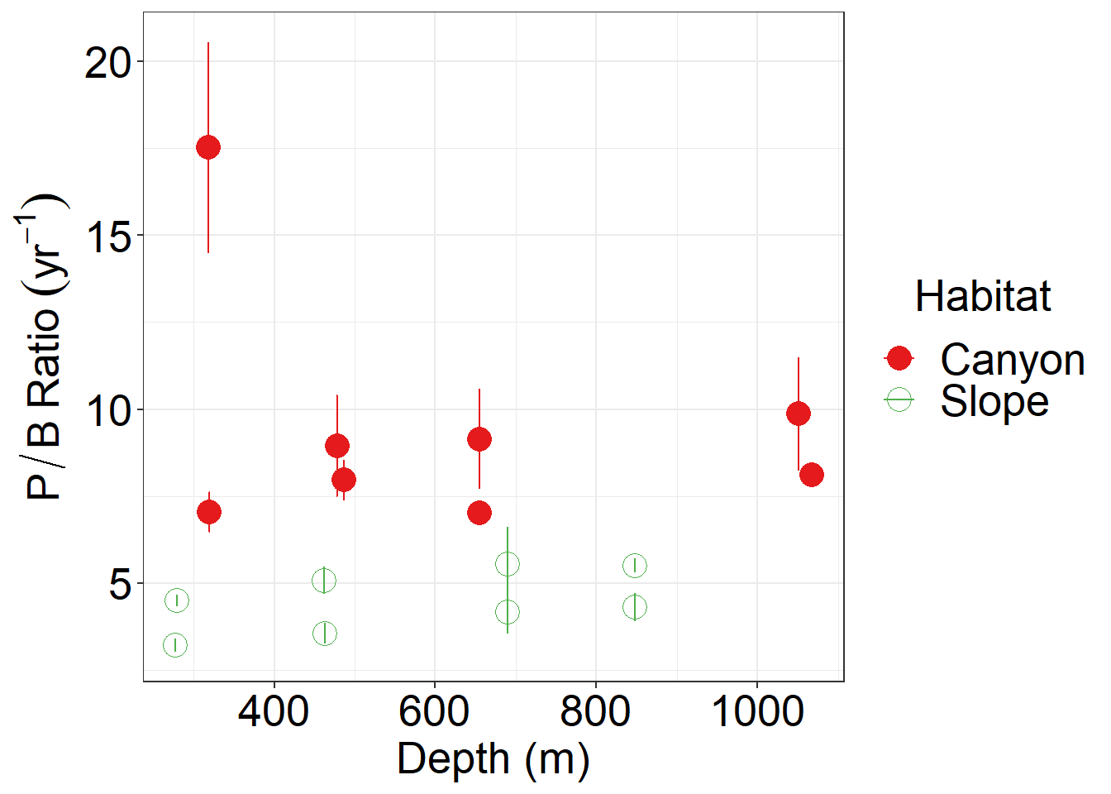
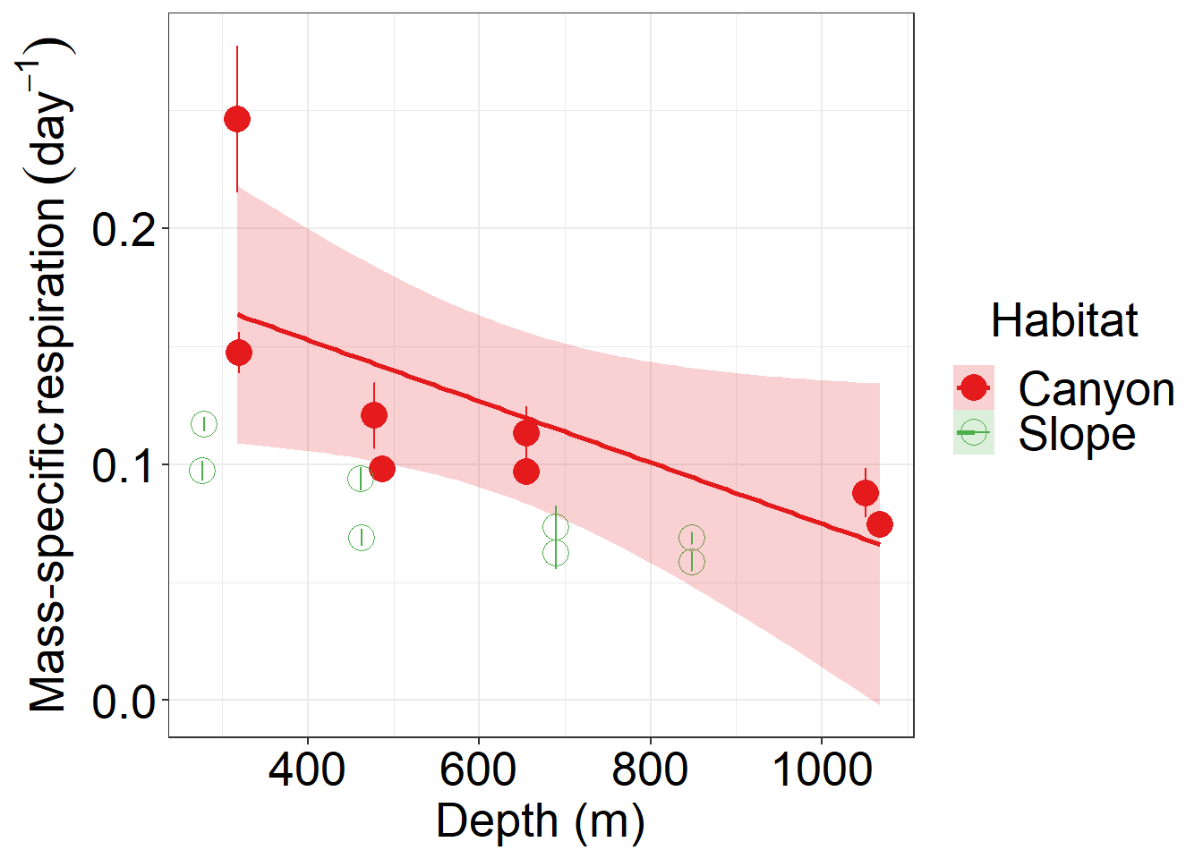
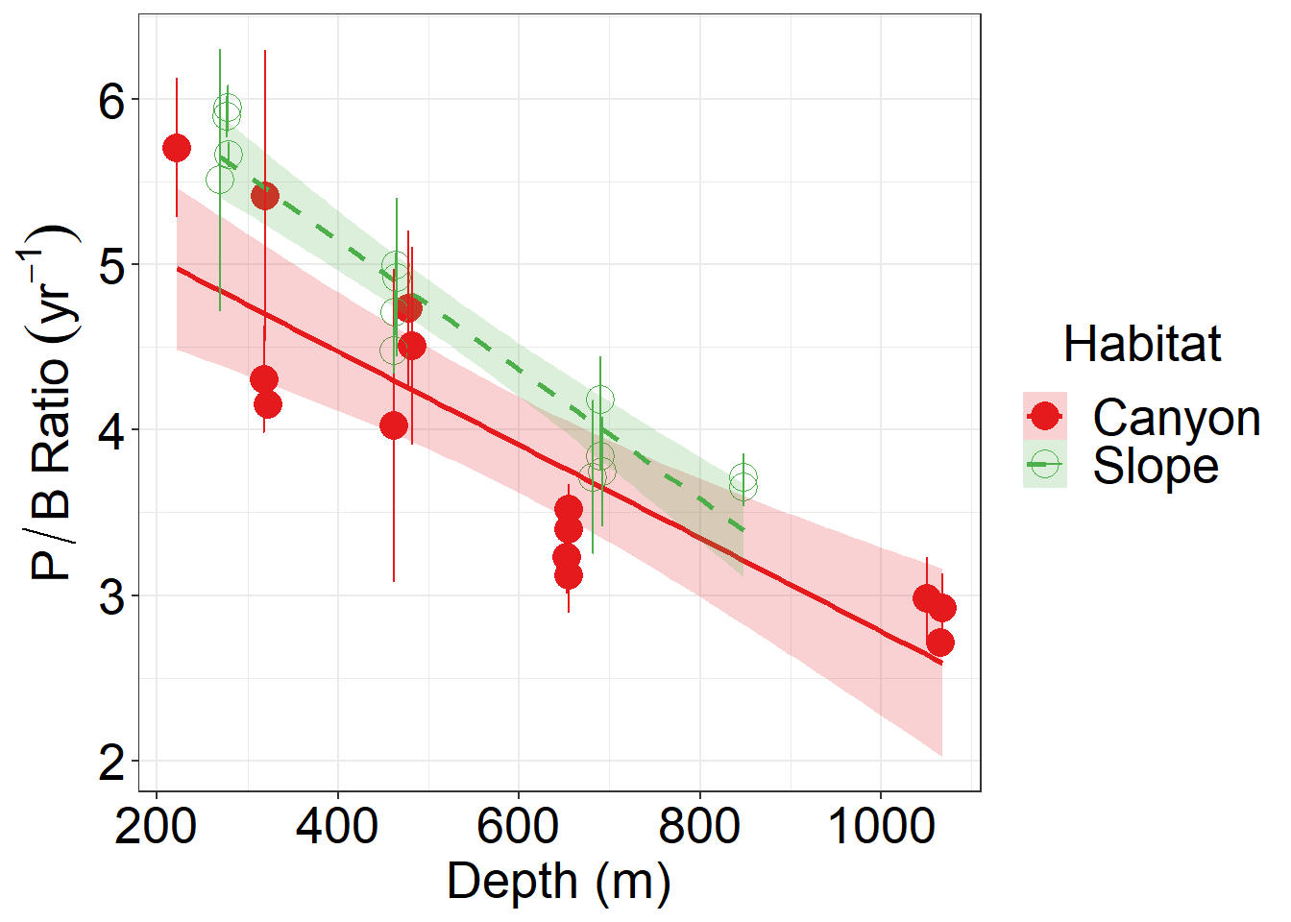
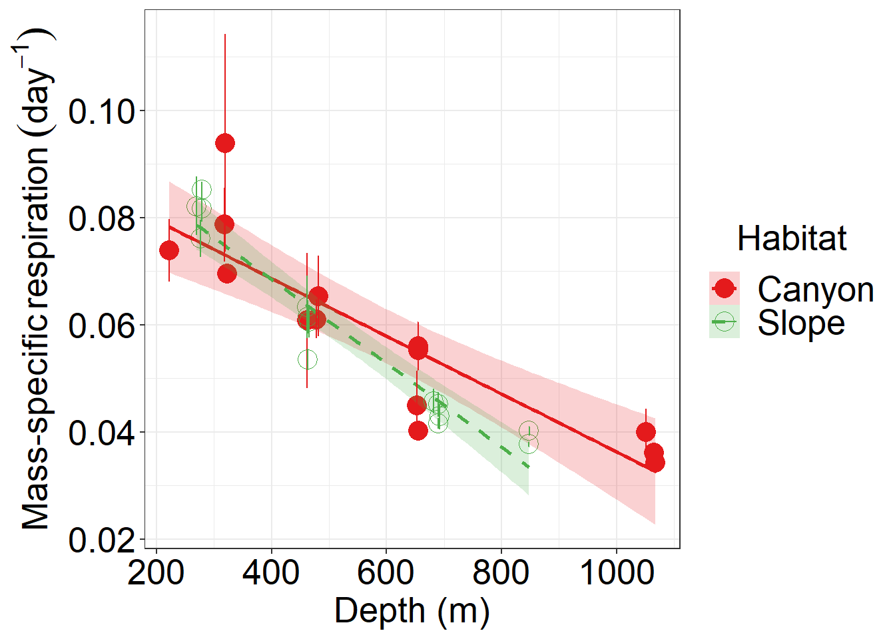
(A)
(B)
(C)
(D)
Notes:
Fig. 4. Production to biomass (P/B) ratio and mass-specific respiration rate of meiobenthos (A-B) and macrobenthos (C-D)

Slide 5
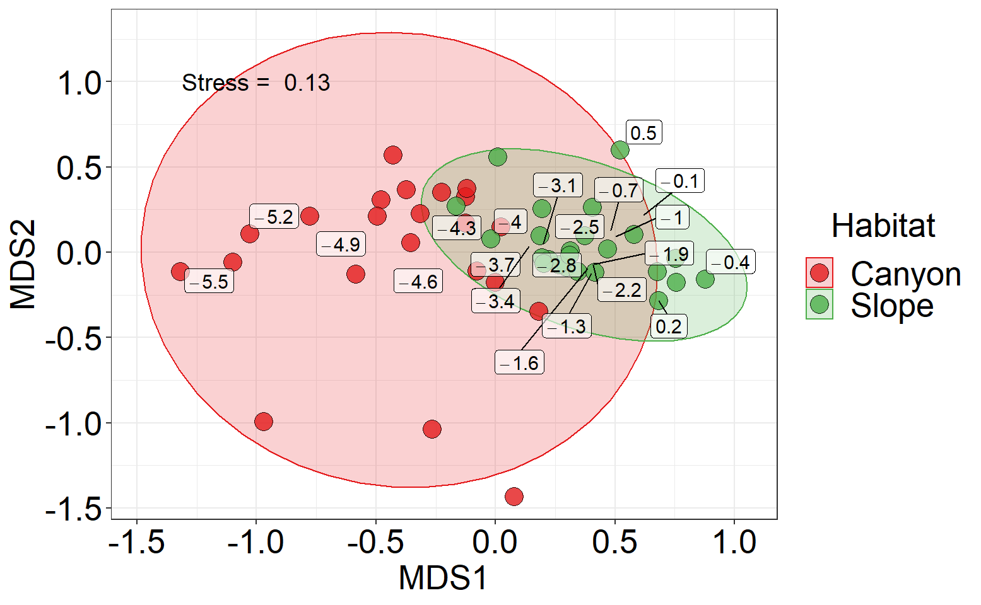
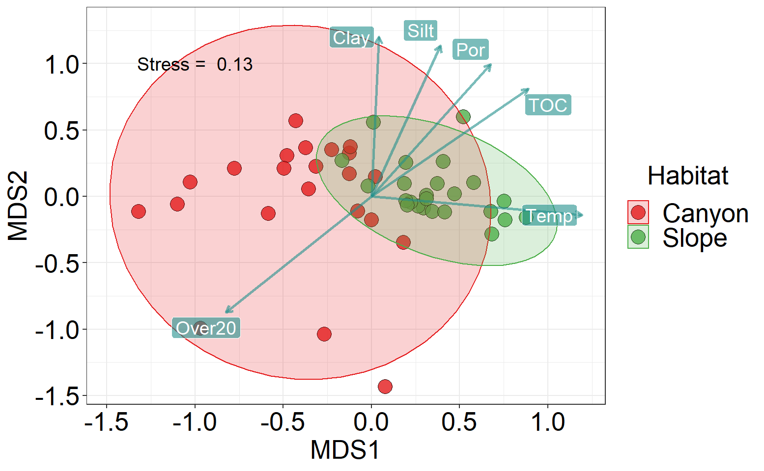
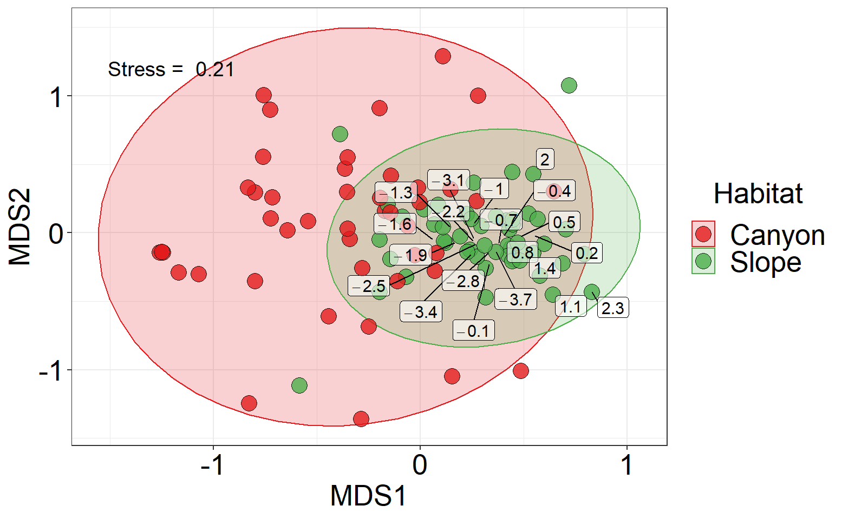
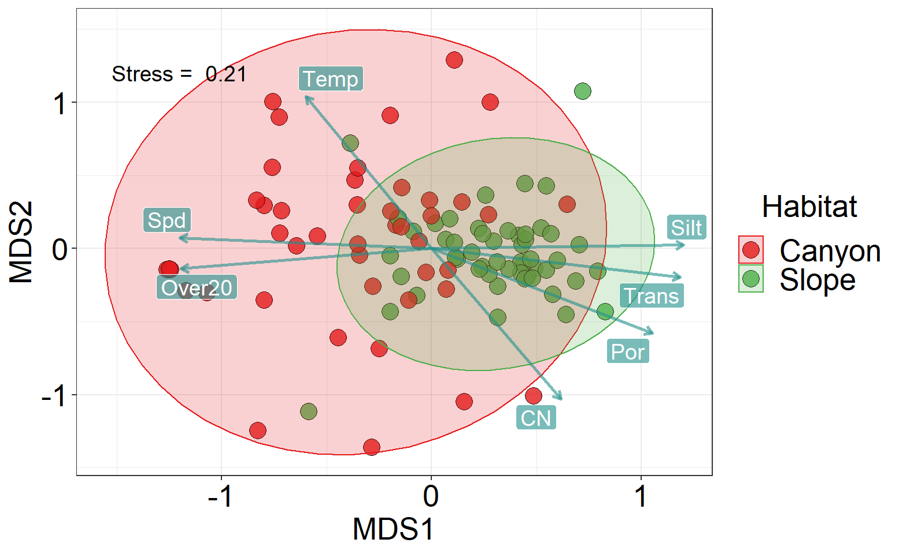
(A)
(B)
(C)
(D)
Notes:
Fig. 5 Body size composition of meiobenthos (A-B) and macrobenthos (C-D)

